Slide 1


GAME OF CHESS AI
PRAVALLIKA MURABOYINA
CHANDANA NAGANDLA
SHARATH CHATURVEDI

Slide 2
CONTENTS
Pre-requisites
Files Included
Board representation
Selection
How the Chess Pieces Move
Evaluating moves
AI Moves – alpha beta pruning
Checkmate

Slide 3
PREREQUISITES
Python 3.10 version
PIP (performance improvement plan) for libraries installation
Libraries:
PyGame - It is an open-source Python programming language module designed to aid in the development of games and other multimedia applications.
Time - Provides ways to represent time in code, including objects, numbers, and strings. It not only represents time, but it also provides functionality such as waiting during code execution and measuring code efficiency.

Slide 4
FILES INCLUDED
• assets folder: Contains all the chess piece sprites used for the game’s graphics.
• chess.py: The main program used to run the interface and game. Run this program when starting the game
• board.py: This contains the board class and its methods. Also contains the alphabet method that the computer uses to make moves
• pieces.py: Contains the master class ‘Pieces’ as well as all individual piece classes that inherit the main class.
• ratings.py: Contains the rating class with methods that evaluate the rating of a movie.
• userInterface.py: Contains the user-interface class that is used to play the game and display the game using pygame

Slide 5
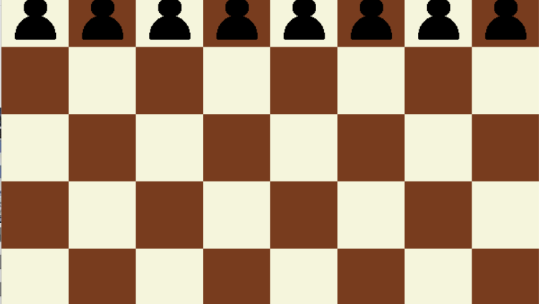
Board representation

Slide 6
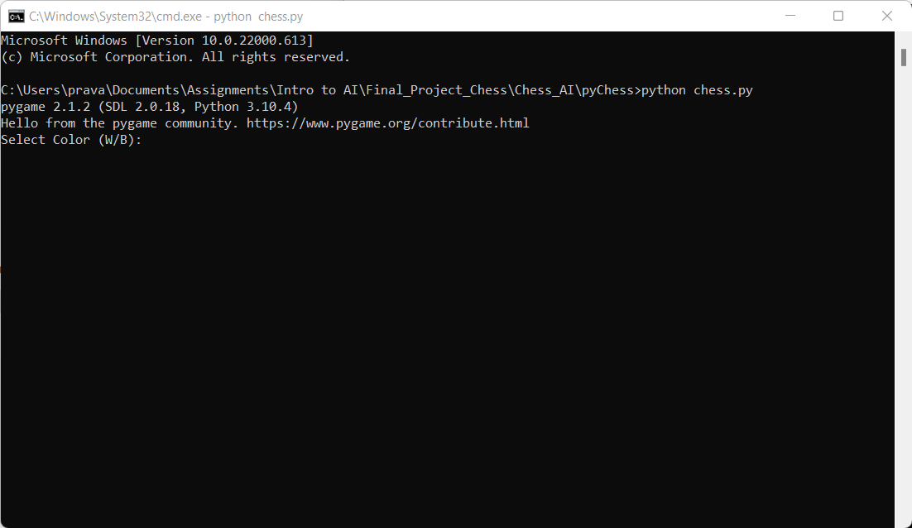
Selection
The player with the white pieces always moves first.
White players get an opportunity to attack right away.

Slide 7
How the Chess Pieces Move
• King
The king, marked with a cross-bearing crown, can move in any direction one square. It can move horizontally, vertically, or diagonally
• Queen
The queen can move any number of squares in any direction – horizontally, vertically, or diagonally. This is the most powerful piece by far.
• Rook
The rook, looking like the tower of a castle, is also a powerful piece. It has the ability to zoom all over the board, horizontally or vertically, any number of squares

Slide 8
Bishop
the bishop can shoot up and down the diagonals of the chessboard.
The bishop can only move on the diagonals, it cannot move to different color squares. In other words, your bishop starting on a light square will always stay on the light squares, while your bishop starting on a dark square will always stay on the dark squares
Knight
The knight moves in an “L” shape, two spaces vertically and one space horizontally, or the opposite: two spaces horizontally and one space vertically.
Pawns
Pawns can move one space forward only unless it’s their first move: then they can move two squares.
Pawns are also the only part of the army that cannot move backward, which is quite an important feature of the game.

Slide 9
Evaluating moves
Ensuring safe and unsafe moves
Checks

Slide 10
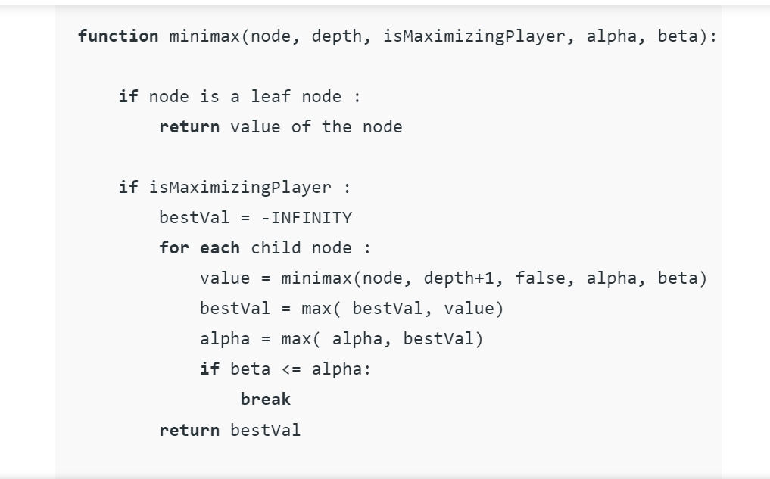
AI Moves – alpha-beta pruning
AI agent move is calculated according to the alpha-beta pruning algorithm
The algorithm maintains two values, alpha and beta, which represent the minimum score that the maximizing player is assured of and the maximum score that the minimizing player is assured of respectively.
Initially alpha = - infinity and beta = + Infinity
The current maximum depth evaluates up to 3 plys; You can set self.MAXDEPTH = 4

Slide 11
CHECKMATE

